Slide 1
R
Numbers
Data Types
( Numeric, complex, Integer )

Slide 2
Numeric
Real
Complex
Integer

Slide 3
Integer/complex
I often seen the symbol 1L (or 2L, 3L, etc) appear in R code. Whats the difference between 1Land 1?
1==1L evaluates to TRUE. Why is 1L used in R code?
Most of the time it makes no difference - but sometimes you can use it to get your code to run faster and consume less memory. A double ("numeric") vector uses 8 bytes per element. An integer vector uses only 4 bytes per element. For large vectors, that's less wasted memory and less to wade through for the CPU (so it's typically faster).

Slide 4
Complex number
1+3i
The way in which complex numbers were first of all mooted, and then made formal, leaves persistent historical traces in the use of the words “real” and “imaginary”.
The 16th century Italian mathematician Gerolamo Cardano is credited with introducing complex numbers in his attempts to find solutions to cubic equations

Slide 5
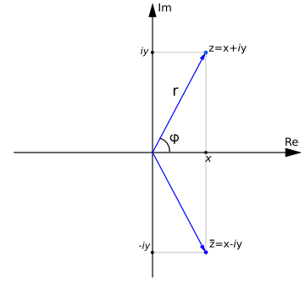
'''Argand diagram.''‘ Imagenary on “Y” axis, Real on X axis

Slide 6
complex numbers
Geometrically, complex numbers are represented on the two-dimensional complex plane as opposed to scalars, represented on the one-dimensional number line.
Scalar – 1D
Complex – 2D
Whereas, we might represent a complex number z by the scalar pair (a,b) [its cartesian coordinates]

Slide 7
'''The complex
It is convenient to represent the complex number [0,1] by the simple symbol i. number i.''‘
The horizontal line displays all the scalar multiples of 1:
the vertical line displays all the scalar multiples of i.
1+3i means 1 on Horizontal line, on vertical line 3
[a, b] = [a, 0] + [0, b] = a [1, 0] + b [0, 1] = a + b i.

Slide 8
A complex number is a number that can be expressed in the form a + bi, where a and b are real numbers, and i is a solution of the equation x² = −1.
Because no real number satisfies this equation, i is called an imaginary number.

Slide 9
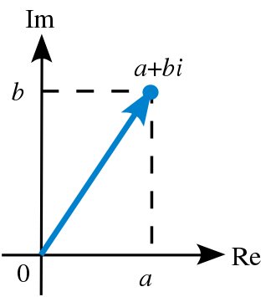

Slide 10
z = 1 + 2i
sqrt(−1)
Instead, we have to use the complex value −1 + 0i.
sqrt(−1+0i)
sqrt(as.complex(−1))

Slide 11
real number
In mathematics, a real number is a value of a continuous quantity that can represent a distance along a line.
The adjective real in this context was introduced in the 17th century by René Descartes, who distinguished between real and imaginary roots of polynomials.

Slide 12
Real Numbers
Rational - > Integer
Rational -> Fractions
Irrational -> eg: Sqrt of 2, pi

Slide 13
From the Constants Section of the R Language Definition:
We can use the ‘L’ suffix to qualify any number with the intent of making it an explicit integer.
So ‘0x10L’ creates the integer value 16 from the hexadecimal representation. The constant 1e3L gives 1000 as an integer rather than a numeric value and is equivalent to 1000L. (Note that the ‘L’ is treated as qualifying the term 1e3 and not the 3.)
If we qualify a value with ‘L’ that is not an integer value, e.g. 1e-3L, we get a warning and the numeric value is created. A warning is also created if there is an unnecessary decimal point in the number, e.g. 1.L.

Slide 14
L specifies an integer type, rather than a double that the standard numeric class is.
> str(1)
num 1
> str(1L)
int 1

Slide 15
What's the difference between integer class and numeric class in R
Integer and Numeric difference?
https://stackoverflow.com/questions/23660094/whats-the-difference-between-integer-class-and-numeric-class-in-r
integers require less storage space.
Numeric can be float or double like 1, 1.25 etc
Integer always 1, no fractions or decimals

Slide 16
There are multiple classes that are grouped together as "numeric" classes, the 2 most common of which are
double (for double precision floating point numbers) and
integer.
R will automatically convert between the numeric classes when needed, so for the most part it does not matter to the casual user whether the number 3 is currently stored as an integer or as a double. Most math is done using double precision, so that is often the default storage.

